Slide 1
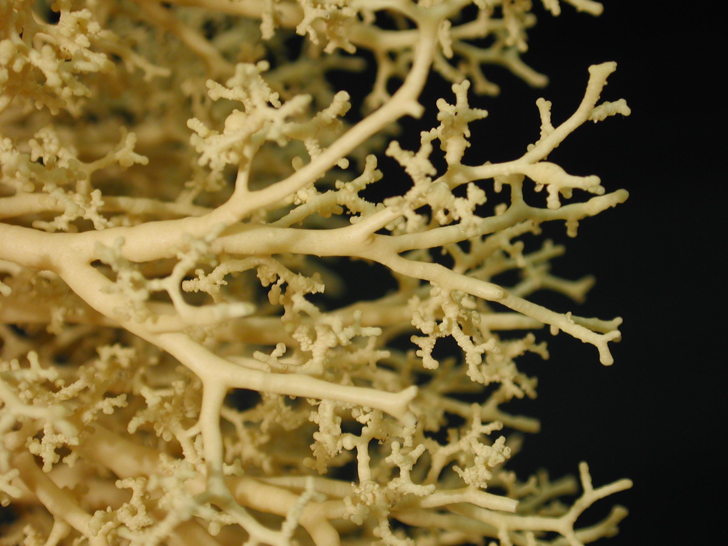

Emergence of lung’s geometry, complex or not?
Benjamin Mauroy
Laboratoire JA Dieudonné,
Université Côte d’Azur, CNRS,
Nice, France.
Systèmes dynamiques et systèmes complexes
JMG60-DAYS
13th June 2018

Slide 2
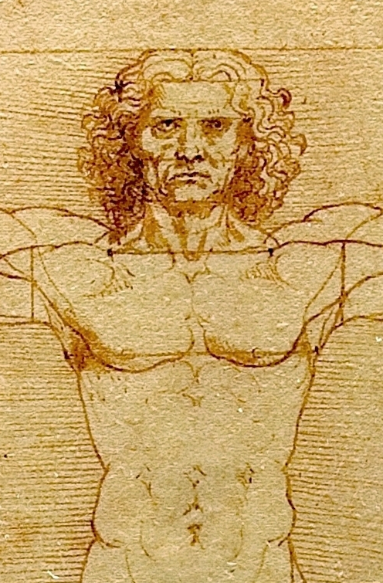
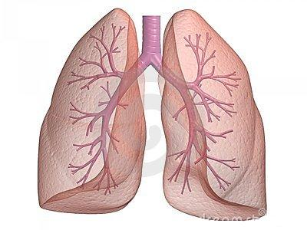

Slide 3
A tree structure

Slide 4
Bronchial tree

Slide 5
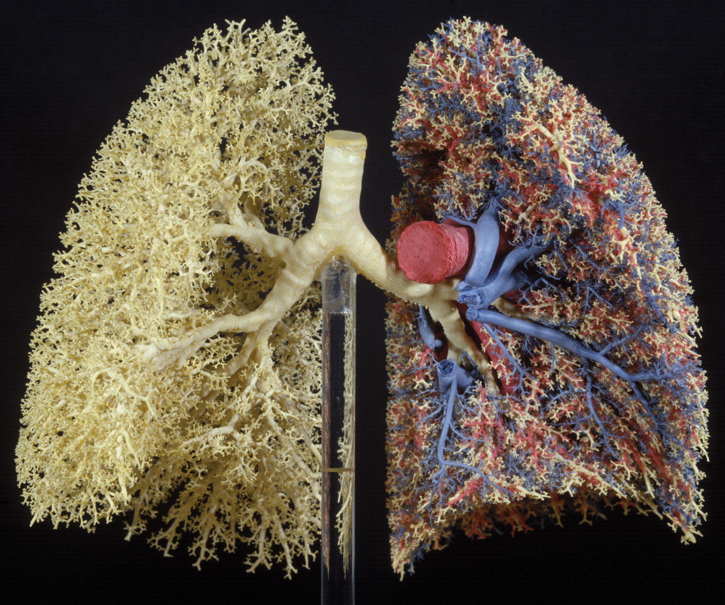
Carbon dioxid
Oxygen
E.R. Weibel (Bern)
Notes:
5

Slide 6
Carbon dioxid
Oxygen
23 bifurcations, asymetrical
16 000 000 bronchi
Surface 100 à 150 m²
Air velocity in trachea
4 km/h (rest)
40 km/h (exercise)
up to 300 km/h (cough)
E.R. Weibel (Bern)
Notes:
6

Slide 7
Exchange surface

Slide 8
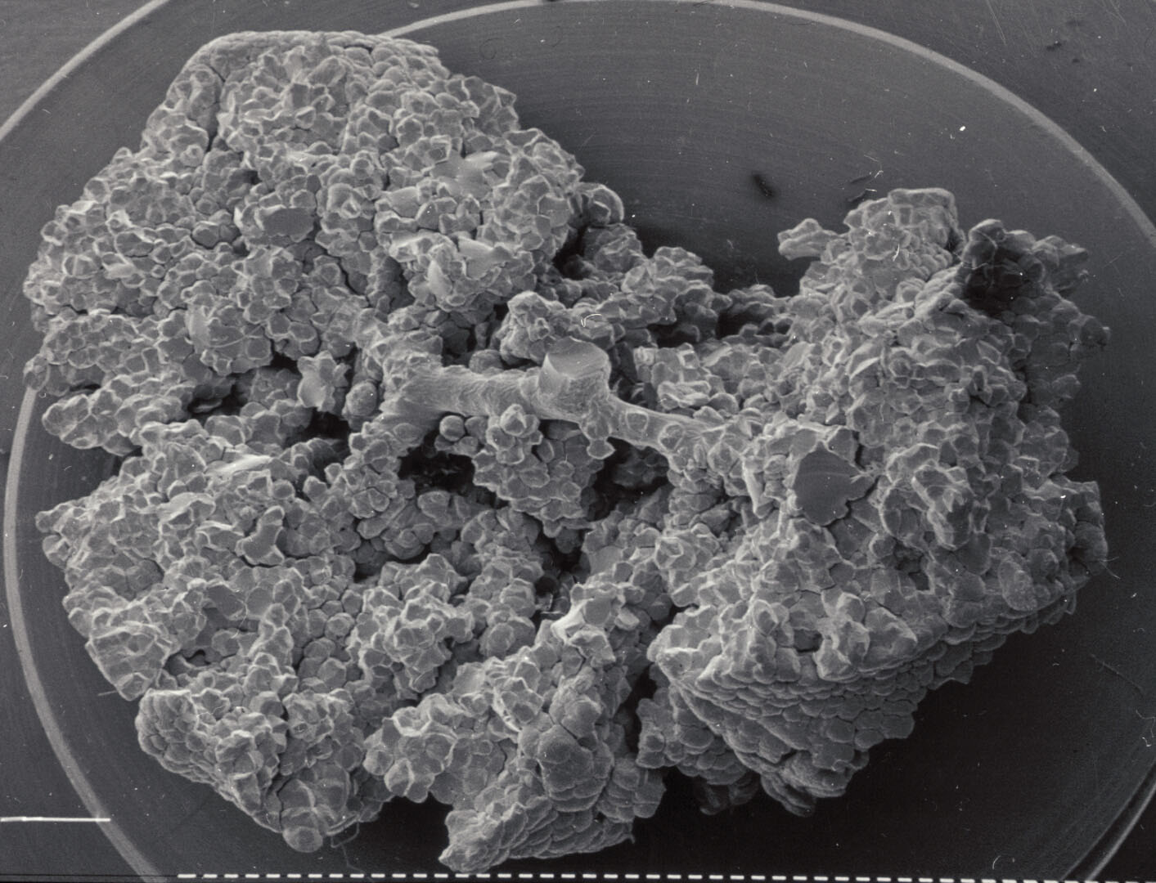
E.R. Weibel (Bern)

Slide 9
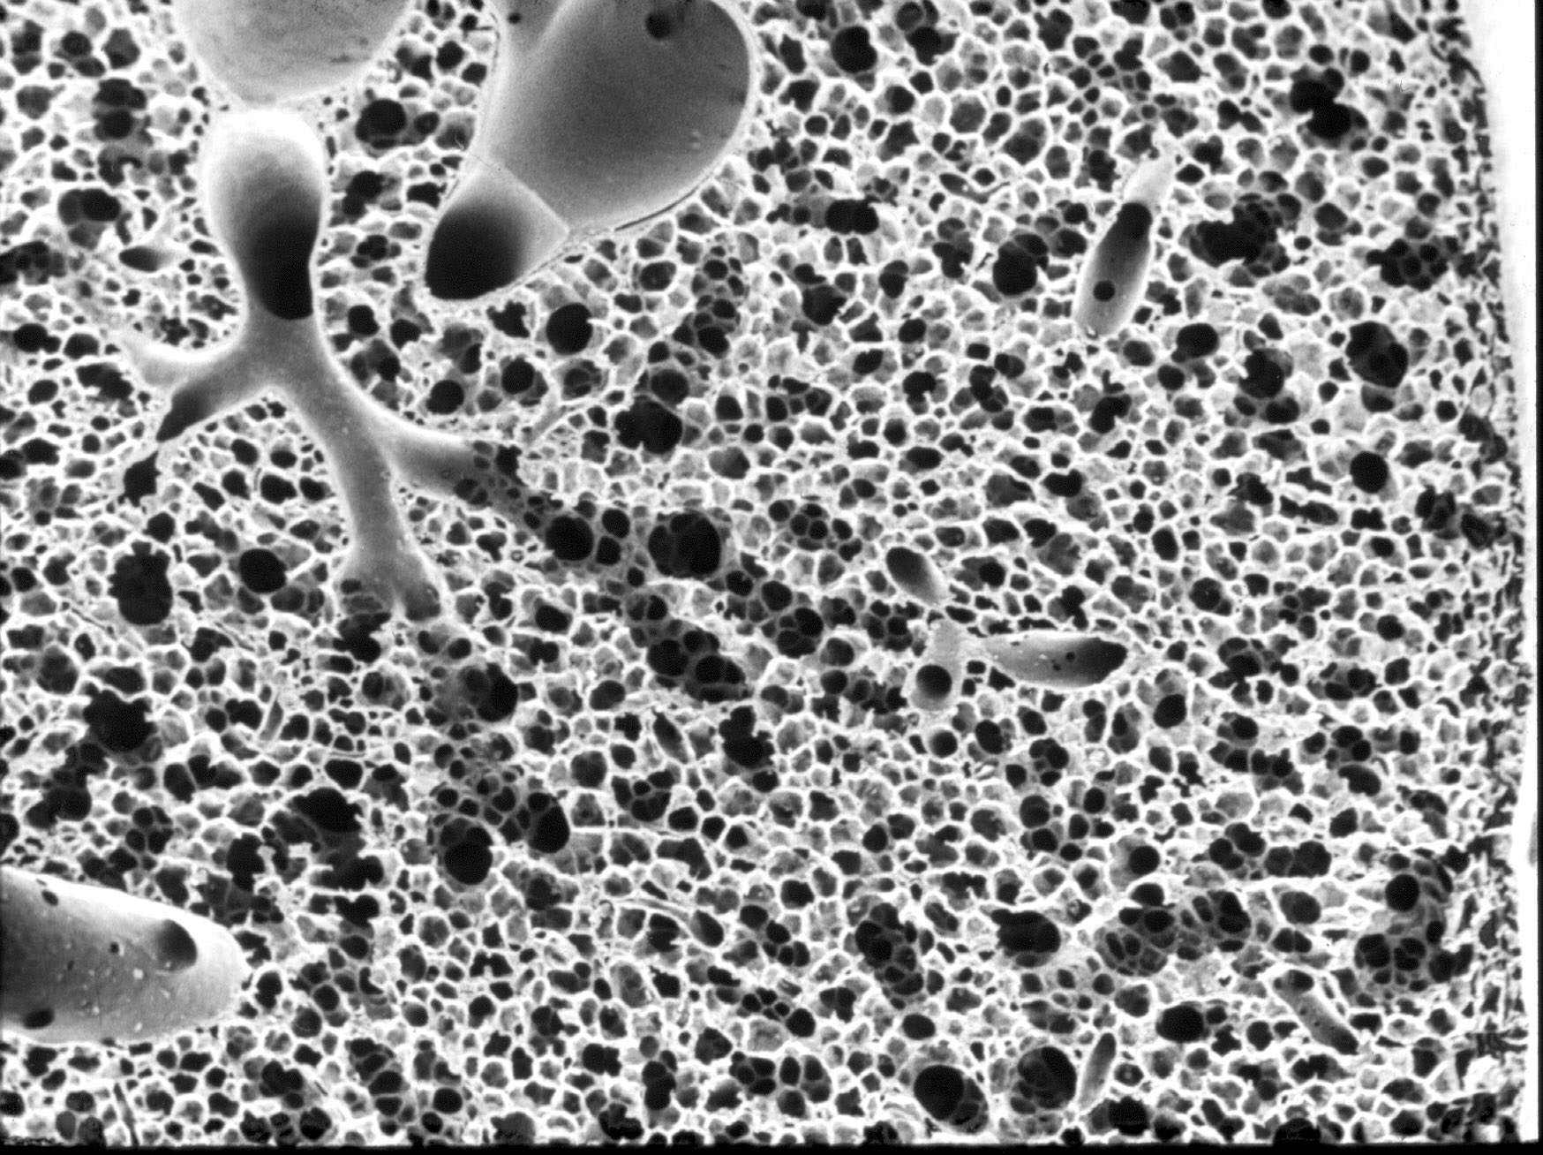
E.R. Weibel (Bern)

Slide 10
Where does this branched geometry come from?
Interaction between two fundamental phenomena

Slide 11
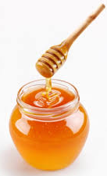
Viscosity

Slide 12
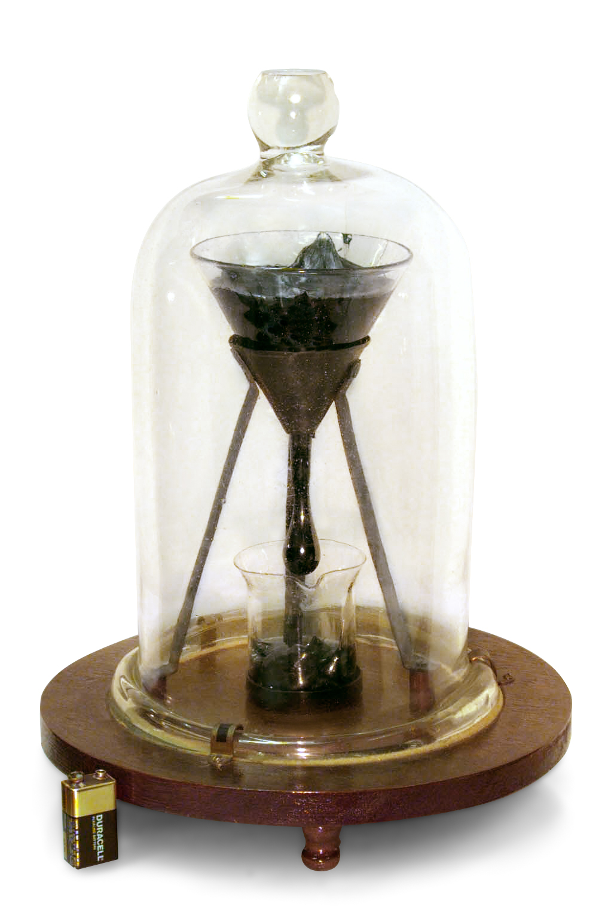
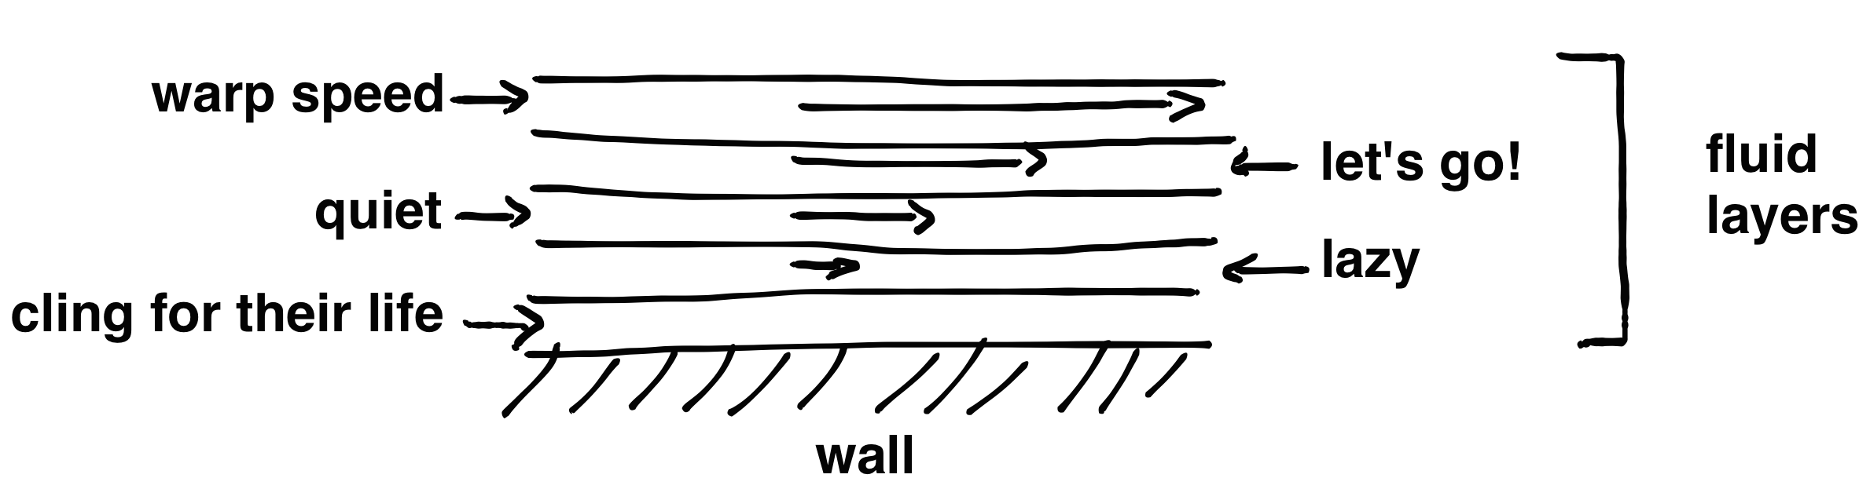
Viscous effects: friction between the fluid layers.
Tendency to velocity homogenization between the layers:
need to provide energy to maintain fluid circulation.
The amplitude of the viscous effects is measured by a number: the viscosity (μ).
Notes:
C’est le Laplacien dans l’équation de Navier-Stokes.
Expliquer que les vaisseaux sanguins et les bronches sont de forme tubulaire et comment la viscosité affecte les écoulements dans un tube.
L’expérience de la goutte de poix (Queensland University), une goutte par décennie! La neuvième goutte est tombée le 23 Avril 2014.
Pitch drop university (Brisbane, Australia).

Slide 13
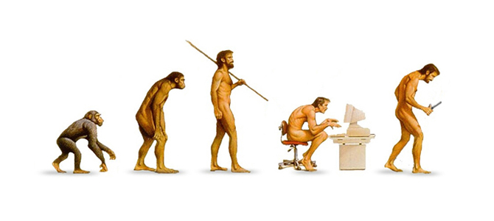
Evolution
Evolution is the transformation over the generations of heritable traits in a population.
Among the forces acting on the evolution:
Natural selection.
Genetic variations.
Notes:
La sélection naturelle : adaptation à l’environnement

Slide 14
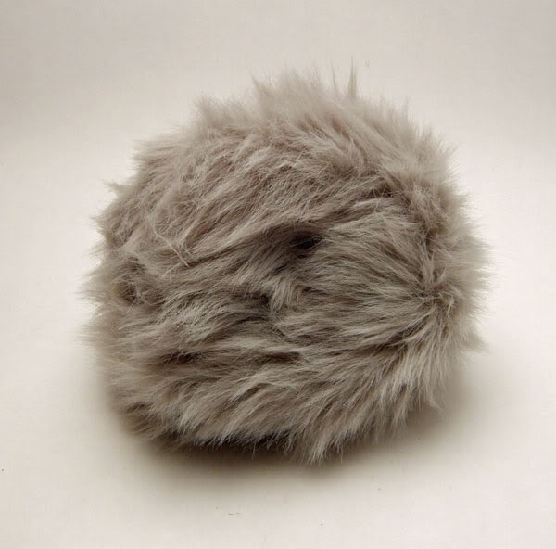
a tribble¹
¹Star Trek, The Original Series, « The trouble with tribbles », 2x05

Slide 15
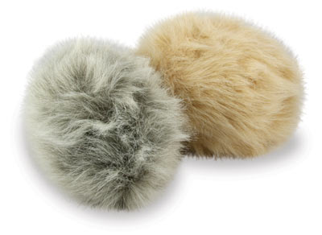
a tribble¹
tribble
mutation
¹Star Trek, The Original Series, « The trouble with tribbles », 2x05

Slide 16
a tribble¹
tribble
mutation
competition
for resources
¹Star Trek, The Original Series, « The trouble with tribbles », 2x05

Slide 17

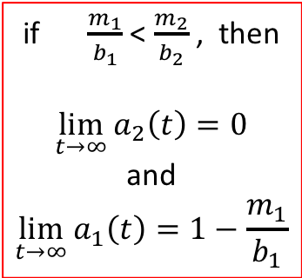
a tribble¹
tribble
mutation
natural selection:
fittest invades the environment
if $\frac{m_{1}}{b_{1}}$ < $\frac{m_{2}}{b_{2}}$ , then
$$\lim_{t→∞}{a_{2}\left(t\right)=0}$$
and
$$\lim_{t→∞}{a_{1}\left(t\right)=1−\frac{m_{1}}{b_{1}}}$$
competition
for resources
¹Star Trek, The Original Series, « The trouble with tribbles », 2x05

Slide 18
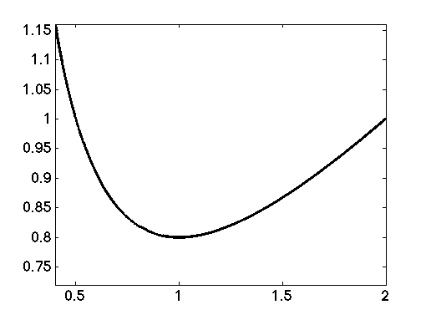
a tribble
tribble
mutation
natural selection:
fittest invades the environment
m/b
biological parameter affecting m/b

Slide 19
Lung is
a complex system
(physics, geometry)
whose emergence is due to
a dynamical system
(evolution)

Slide 20
Why such a geometry?

Slide 21

Optimal distribution network…
?
?
?
here !
?
a cost
network shape
… but for what cost?
This is where the modeling process and viscosity come into play.
Notes:
To give life back to ghost traits.

Slide 22
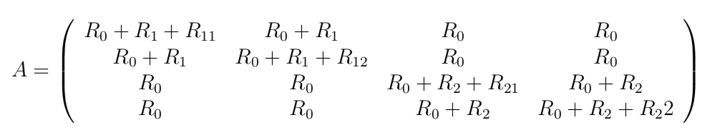
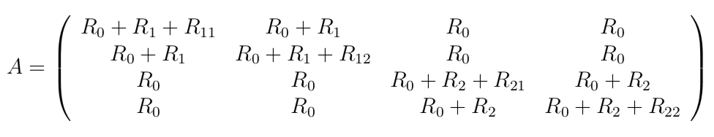
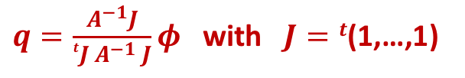
p₀,q₀
…
p_{M},q_{M}
The energy lost because of viscous effects is :
E_{d} = ^{t}q A q
The flow distribution that minimizes viscous energy loss checks
$q=\frac{A^{−1}J}{tJ{ A}^{−1} J}φ$ with $J=t$(1,…,1)

Slide 23
k_{1,j}
h_{1,i}
major
minor
k_{2,j}
h_{2,i} = a h_{1,i}

Slide 24
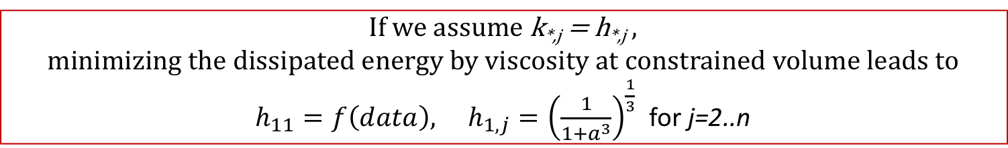
k_{1,j}
h_{1,i}
major
minor
k_{2,j}
h_{2,i} = a h_{1,i}
If we assume k_{*,j} = h_{*,j} ,
minimizing the dissipated energy by viscosity at constrained volume leads to
$h_{11}=f\left(data\right), h_{1,j}={\left(\frac{1}{1+a^{3}}\right)}^{\frac{1}{3}}$ for j=2..n
Data : a $\sim$ 0.79 d’où h_{1,j} $\sim$ 0.88 (j > 1) et h_{2j} $\sim$0.69 (j > 1)
Measurements gave h₁ between 0.84 and 0.94; and h₂ between 0.67 and 0.76.
(Tawhai 2004, Delclaux 2008)

Slide 25

How is it built?

Slide 26
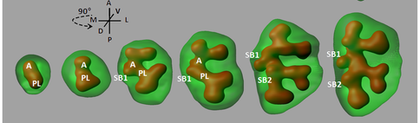
Lung development.
green = external boundaries of the organ / red = bronchi walls
P. Blanc et al, Plos One, 2012
Growth occurs at bronchi tips
Real time adaptation of the bronchi to organ geometry

Slide 27
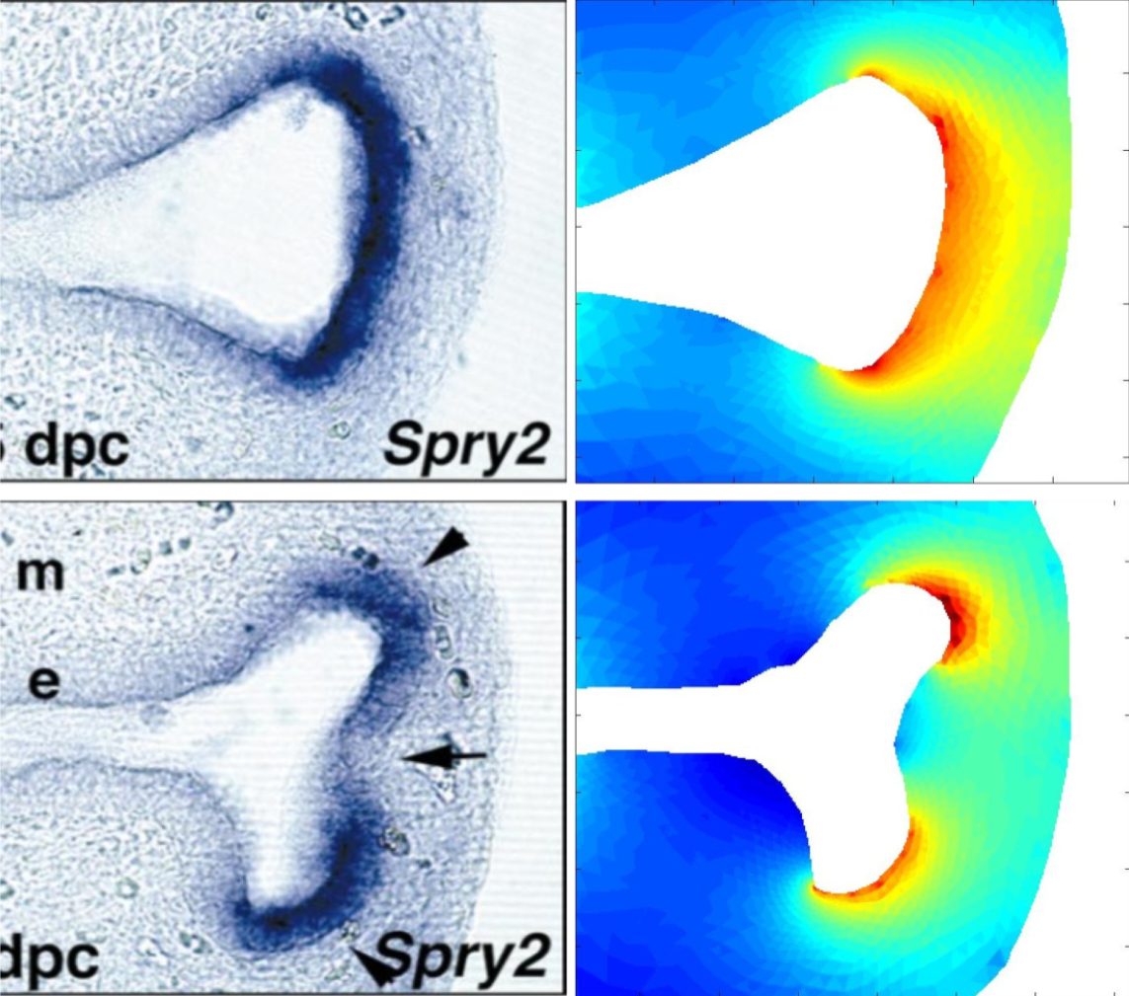
FGF10 protein dynamics
FGF10 flux are sensible to
the distance from FGF10 source and
to the local curvature (tip effect)
This behavior can be modeled by a phenomenon of diffusion of FGF10 from the organ external wall, toward the bronchi walls.
The growth of tissue walls of the bronchial tubes is then
a function of the flow of FGF10 received.
Notes:
16/06/11
27
16/06/11
27
TIP EFFECT – LIGHTNING RODS
GOOD MODEL FOR THE DYNAMICS OF FGF10
27

Slide 28

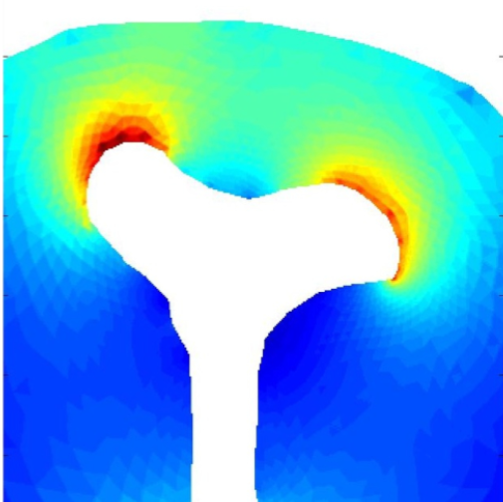
Tip effect of the Laplacian

Slide 29
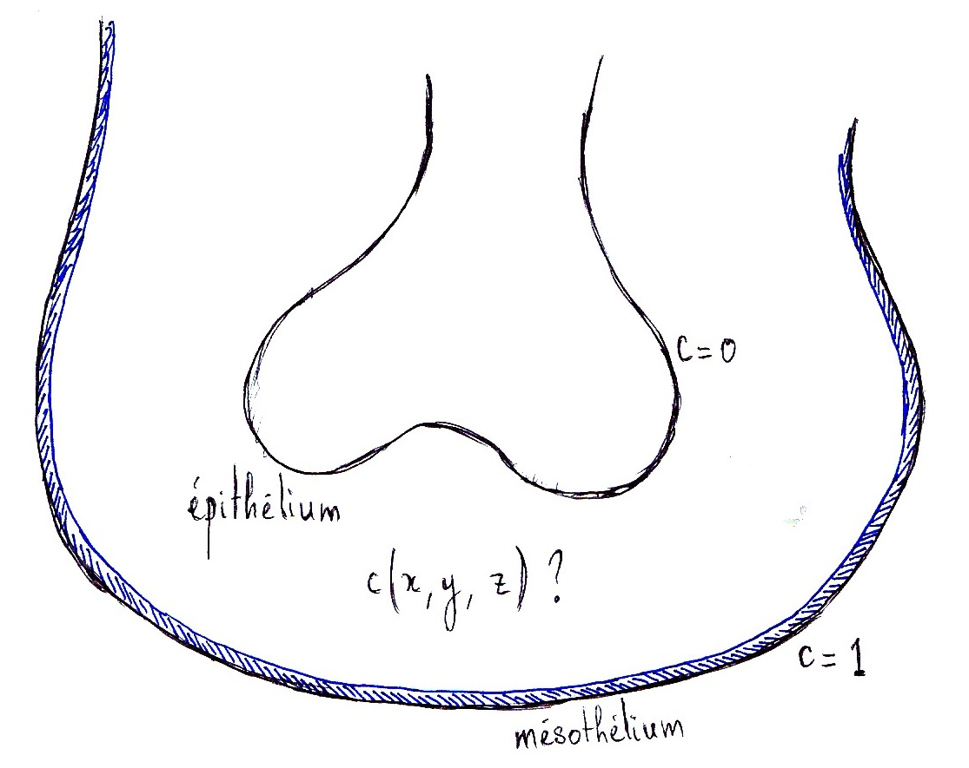
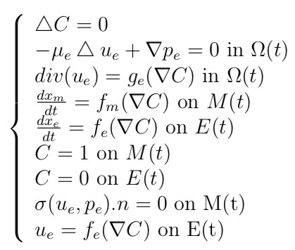

R. Clément
M(t)
E(t)
$$Ω(t)$$

Slide 30
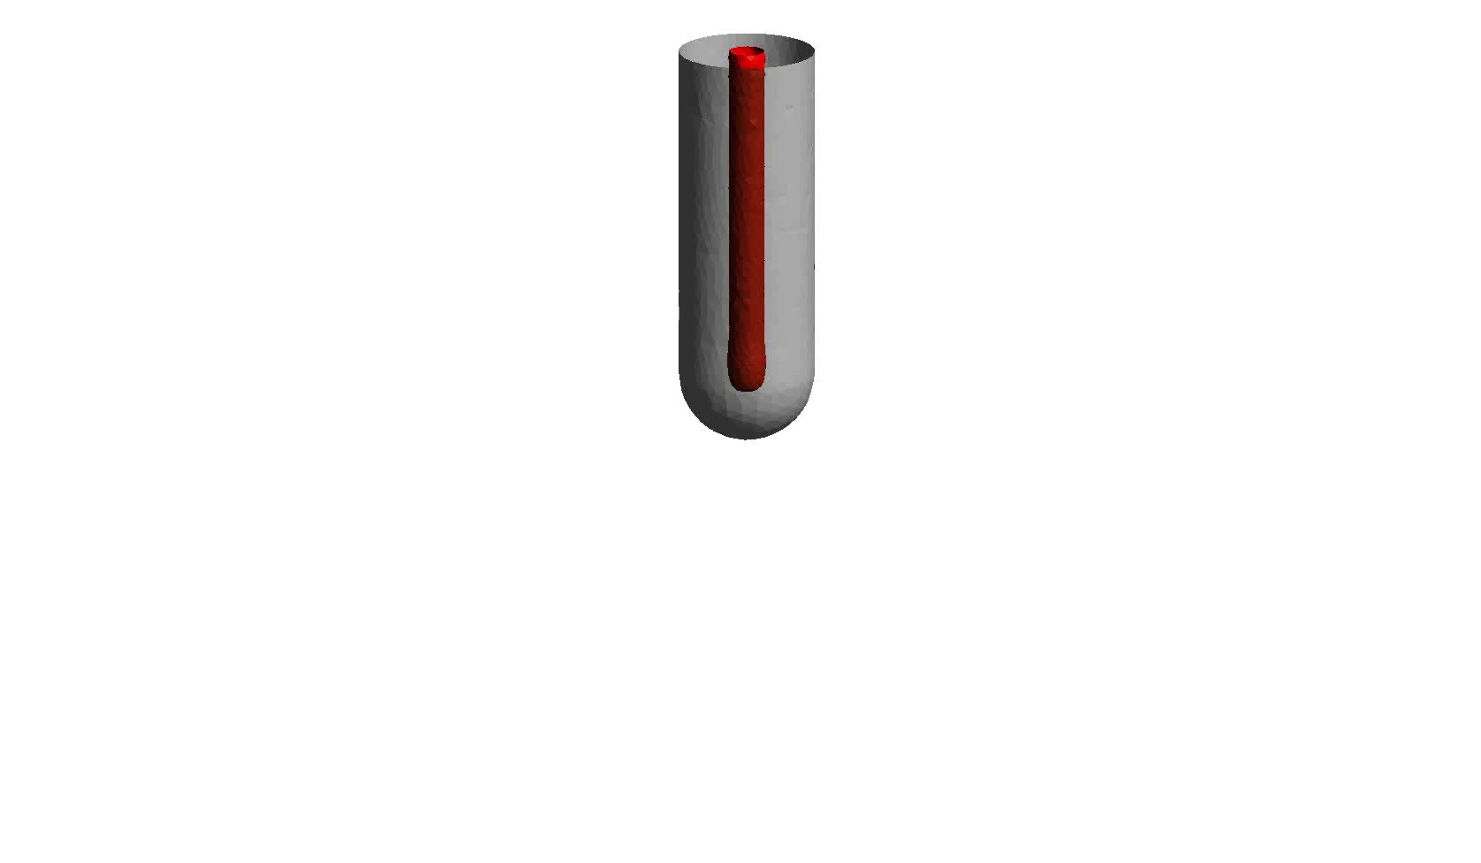
Growth simulations (Freefem++)
Spontaneous emergence of topological characteristics.
Notes:
16/06/11
30
CA MARCHE TOUT SEUL (PAS DE ROUTINE DE BRANCHEMENT).
DIFFERENT DES L SYSTEMS ET COMPAGNIE
FREEFEM ELEMENTS FINIS

Slide 31
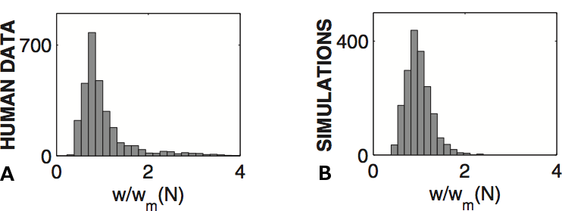
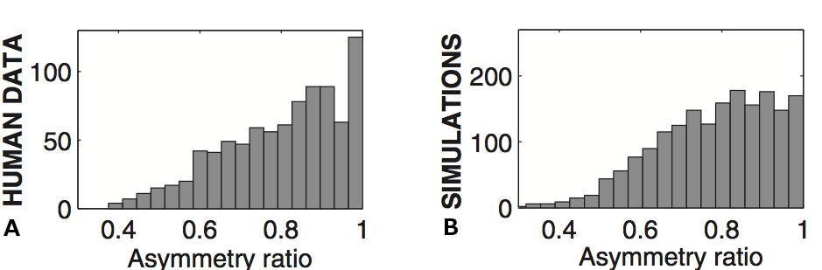
Diameters distribution.
Data set : Raabe et al (1976)
The noise affecting the size of the bronchi involves:
1 - an uncertainty on lung geometry
2 - an asymmetry of the pulmonary bifurcation
Notes:
16/06/11
31
L’instabilité génère robustement de la variabilité, avec les mêmes dispersion que chez l’humain
Pas d’encodage spécifique nécessaire, juste du bruit
Le bruit sur la taille des bronches est lié à l’encombrement.
Asymmétrie : travaux de Bernard.

Slide 32
Relating why and how:
linking lung’s development to lung’s function.

Slide 33
Why and how do bronchi sizes decrease with generations?
homothetic growth (global growth of the organ) at rate k
bronchi
gradient induced growth of the bronchi at velocity v

Slide 34
Why and how do bronchi sizes decrease with generations?
homothetic growth (global growth of the organ) at rate k
bronchi
gradient induced growth of the bronchi at velocity v
The bronchi diameter D and the bronchi length L check the equations :

Slide 35
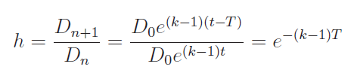
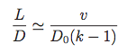
Why and how do bronchi sizes decrease with generations?
homothetic growth (global growth of the organ) at rate k
bronchi
gradient induced growth of the bronchi at velocity v
The bronchi diameter D and the bronchi length L check the equations :
Then calling T the mean time between two bifurcations and D₀ the bronchi diameter at its emergence (instability size) :

Slide 36
Role of noise on evolutive stable strategy

Slide 37
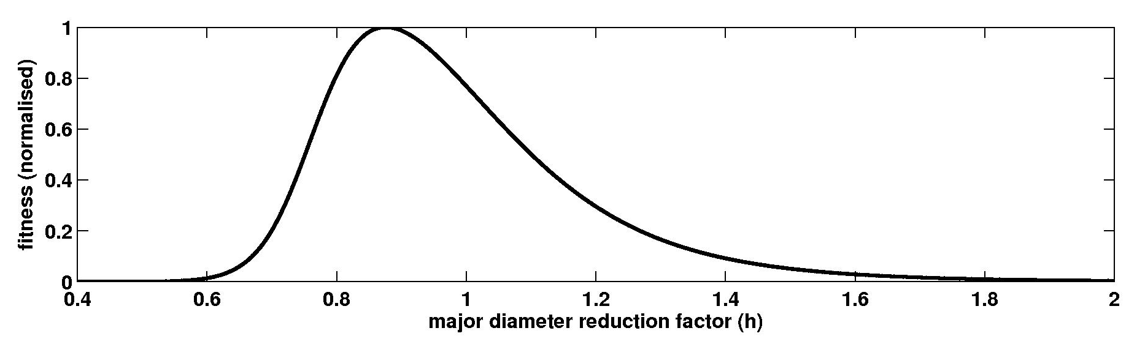
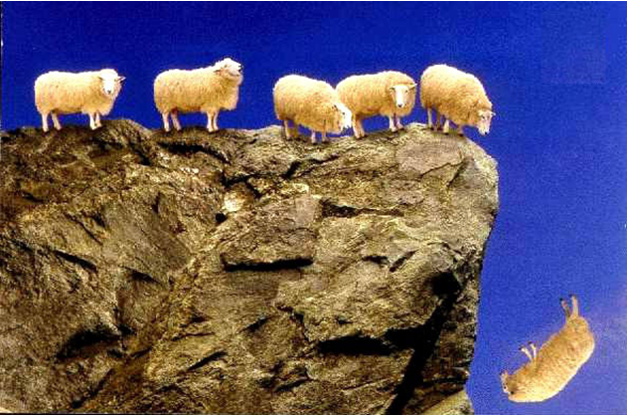
Shape of the cost function

Slide 38
Let a be a species with genotype k.
The offspring get also the genotype k, but this genotype is expressed (phenotype) according to a distribution G(h,k).
Then the distribution of the phenotypic trait in the population follows the equation:

Slide 39
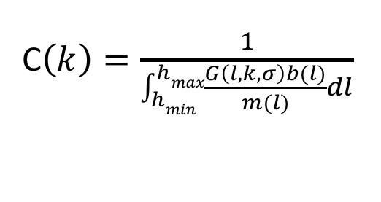
Let a be a species with genotype k.
The offspring get also the genotype k, but this genotype is expressed (phenotype) according to a distribution G(h,k).
Then the distribution of the phenotypic trait in the population follows the equation:
Then the cost is now
C$\left(k\right)=\frac{1}{\int_{hmin}^{hmax}{\frac{G\left(l,k,σ\right)b(l)}{m(l)}}dl}$

Slide 40
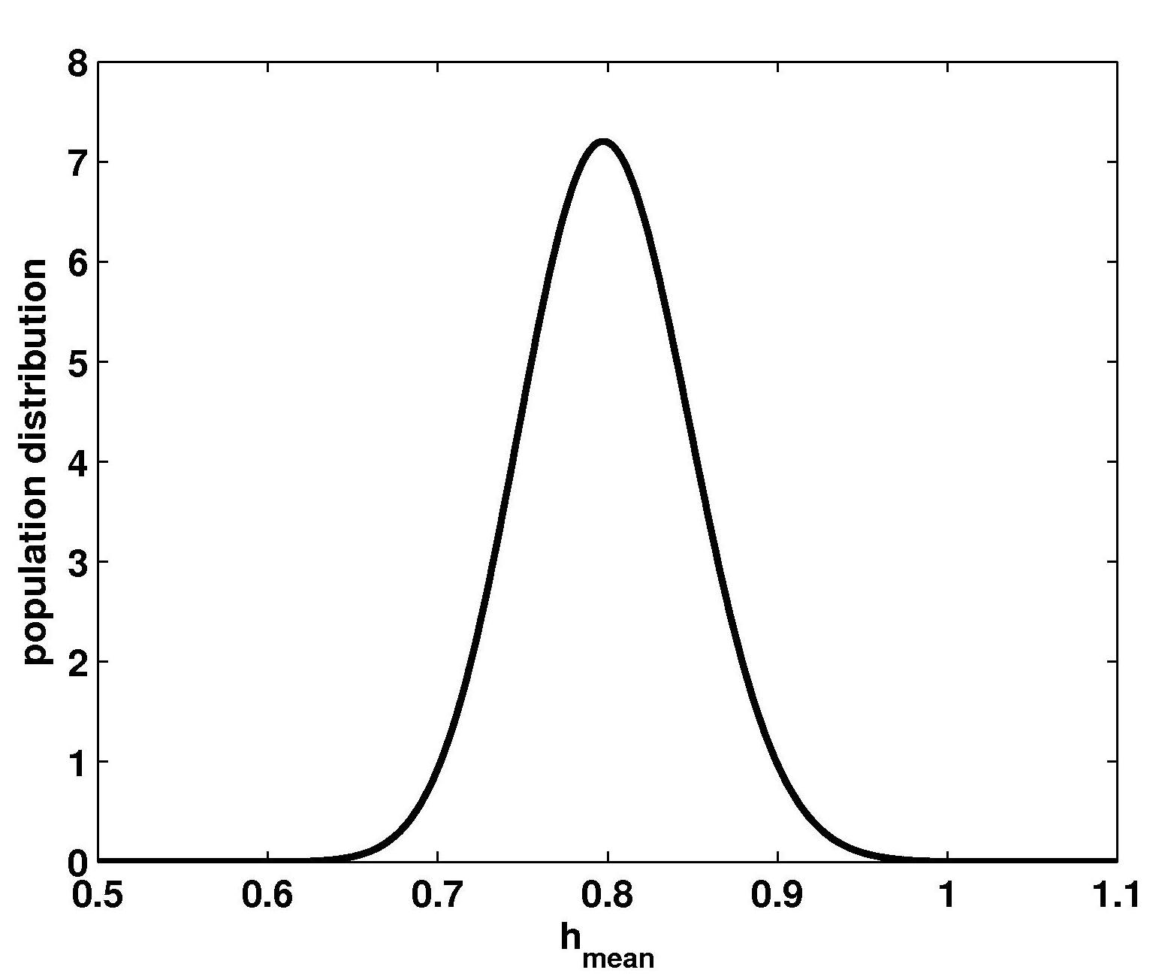
Prediction of the population distribution (with h_{maj}=0.89 / h_{min}=0.64 (h_{moy}=0.8) and a standard deviation σ=0.06).
This distribution shows the existence of individuals in the population whose bronchial tree is less effective (asthme?).
Influence of variability on the optimal shape of a dichotomous airway tree branching asymmetrically,
B. Mauroy, P. Bokov, Phys. Biol. 7 (1) 016007, 2010.

Slide 41
We are able to link
cells’ behaviors during lung’s development
(parameters T, k, v, D₀)
to
adults lung’s function
(parameters h, L/D, asymetry ratio, flow properties)

Slide 42
Conclusions
Is lung a complex system?

Slide 43
Is lung a complex system ?
Probably … but its geometry exists as the assembly of « basic » phenomena

Slide 44
Is lung a complex system ?
Probably … but its geometry exists as the assembly of « basic » phenomena
Lung’s geometry is a tree.
Change of sizes in bifurcation checks a universal scaling rule
that minimizes viscosity effects.
Development of the lung is the consequence of
a protein diffusing from one interface to an other.

Slide 45
Thank you Jean-Marc
for all you did and do for
complex systems,
dynamical systems
and
interdisciplinarity

Slide 46
Thank you Jean-Marc
for all you did and do for
complex systems,
dynamical systems
and
interdisciplinarity
Happy birthday !

